Slide 1

Implementation of a High-Speed CMOS Comparator with 8-bit Resolution
CE - ECE 462 - CMOS ANALOG AND MIXED SIGNAL IC DESIGN
Prepared by group 15
AP22110020100- RIithik
AP22110020101-Vinuthna
AP22110020102-Raheela
AP22110020103-Divya deekshitha
AP22110020104-Sudeep

Slide 2
Introduction
Comparators are essential building blocks in analog-to-digital converters (ADCs), used to compare two voltages and produce a digital output. The main performance parameters of a comparator are speed, accuracy, and power consumption. Achieving 8-bit resolution in CMOS technology is a challenge due to device mismatches and limitations in speed. This paper presents a comparator that overcomes these limitations.

Slide 3
What is an 8-bit Comparator?
An 8-bit comparator is an electronic circuit that compares two input voltages and gives a digital output — either HIGH (1) or LOW (0).
It is called 8-bit because it can detect very small voltage differences, just like how 8-bit numbers can represent 256 different values (from 0 to 255).
If Vin1 is greater than Vin2, the output is HIGH
If Vin1 is less than Vin2, the output is LOW
An 8-bit comparator is used when we need precise and fast comparisons between voltages, such as in Analog-to-Digital Converters (ADCs), sensor circuits, and communication systems.

Slide 4
What is a Flip-Flop?
A flip-flop is a basic digital circuit used to store one bit of data — either a 0 or a 1.
In simple terms, you can think of a flip-flop like a tiny memory cell that remembers whether the last signal it received was a HIGH or a LOW.
In our comparator project, the flip-flops are used to amplify small differences between the two input voltages. They act like a decision-maker: once a small difference is detected, the flip-flop quickly moves to either a HIGH or LOW output and helps make the comparison very fast using positive feedback. The flip-flops help achieve high speed and low power consumption by operating in a dynamic

Slide 5
What is an SR Latch?
An SR latch (Set-Reset latch) is a simple digital circuit that can also store one bit of information — just like a flip-flop — but works differently.
It has two inputs:
S (Set) → makes the output HIGH
R (Reset) → makes the output LOW
In our comparator, the SR latch is used after the flip-flops to hold the final output value. Even after the comparison is over, the SR latch keeps the output stable until the next clock cycle. This prevents unwanted changes or glitches in the output.

Slide 6
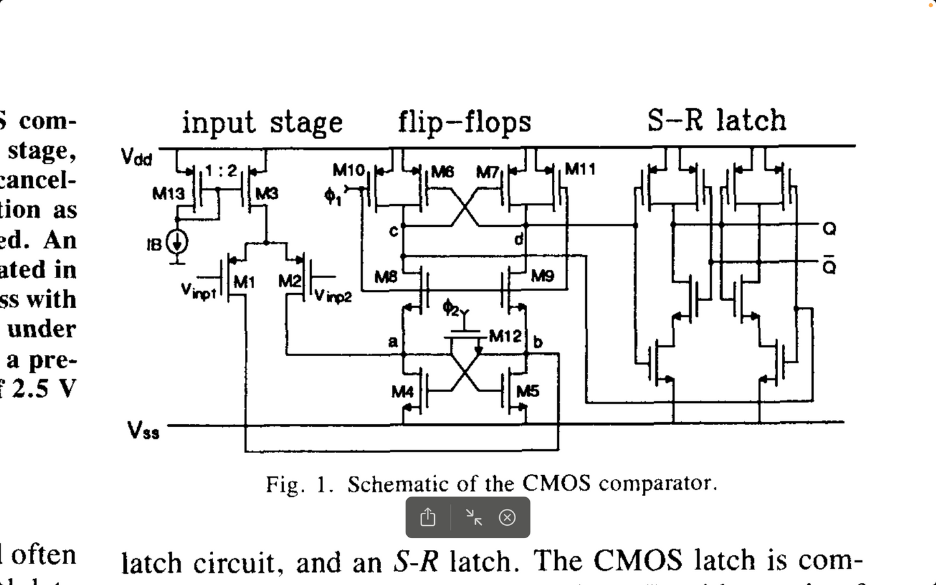
CMOS comparator circuit
The comparator is divided into three main blocks:
Input Stage
Flip-Flop Stage
S-R Latch
.Input Stage
Consists of transistors M1, M2, M3, M13 and a current source IB.
Inputs Vinp1 and Vinp2 are applied to differential pair M1 and M2.
M3 acts as an active load with current mirroring from M13
Performs voltage comparison and generates currents based on input difference.
Flip-Flop Stage
Contains cross-coupled transistors M6, M7 and clock-controlled transistors M8, M9, M10, M11, M12.
Operates during two clock phases: Φ1 and Φ2.
Captures the result of input comparison and amplifies it.
S-R Latch
Built using CMOS NOR-based latch.
Uses outputs from the flip-flop stage as Set (S) and Reset (R) inputs.
Maintains stable output even after clocking phase ends.
Key Features
Fully CMOS implementation → Low power, high speed.
Produces reliable digital output based on analog voltage comparison.
Suitable for high-speed ADCs and digital signal processing systems.
.

Slide 7
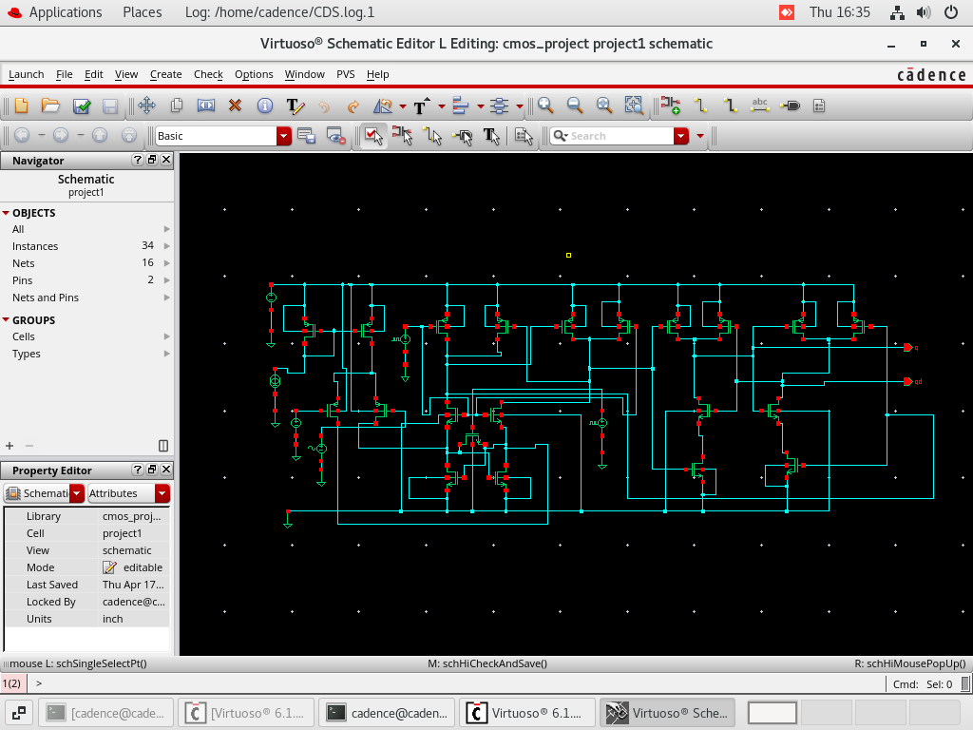
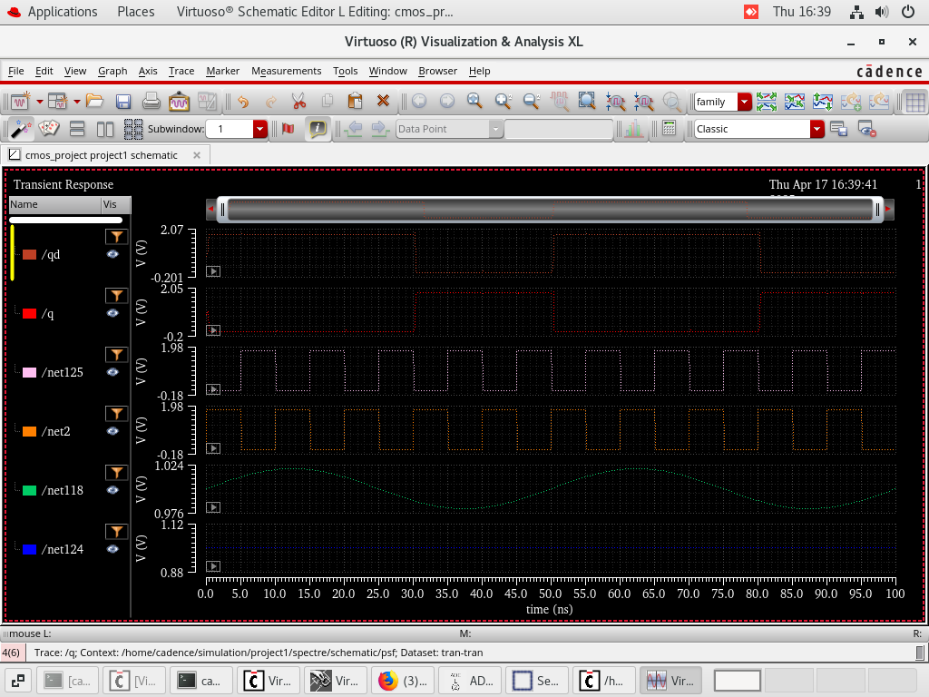
Simulation and Output Analysis

Slide 8
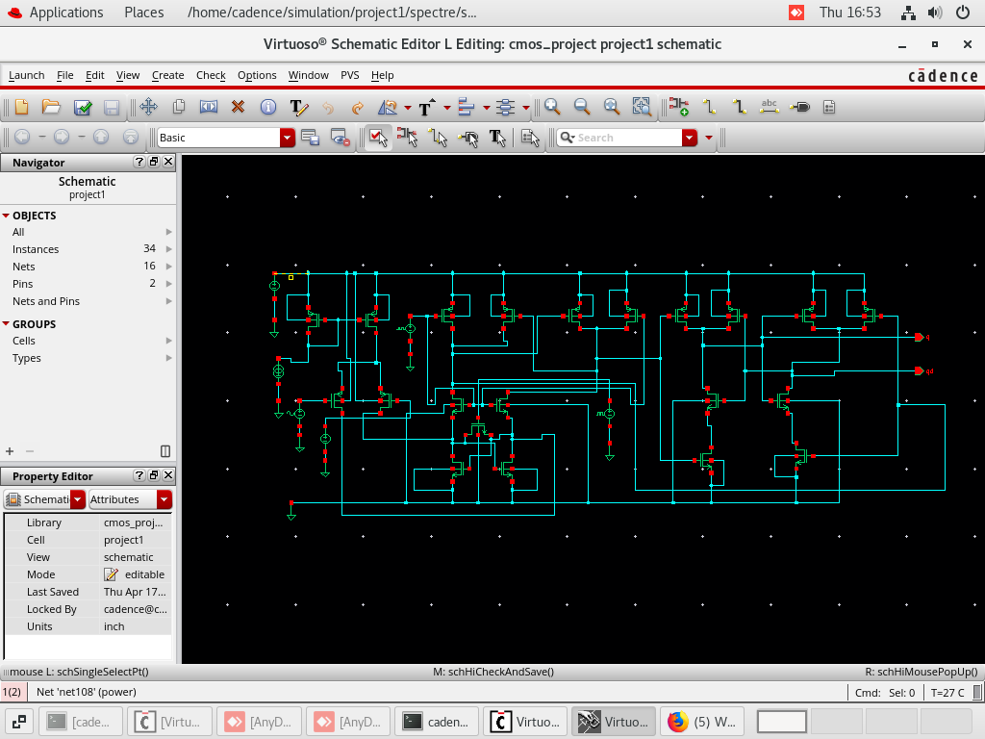
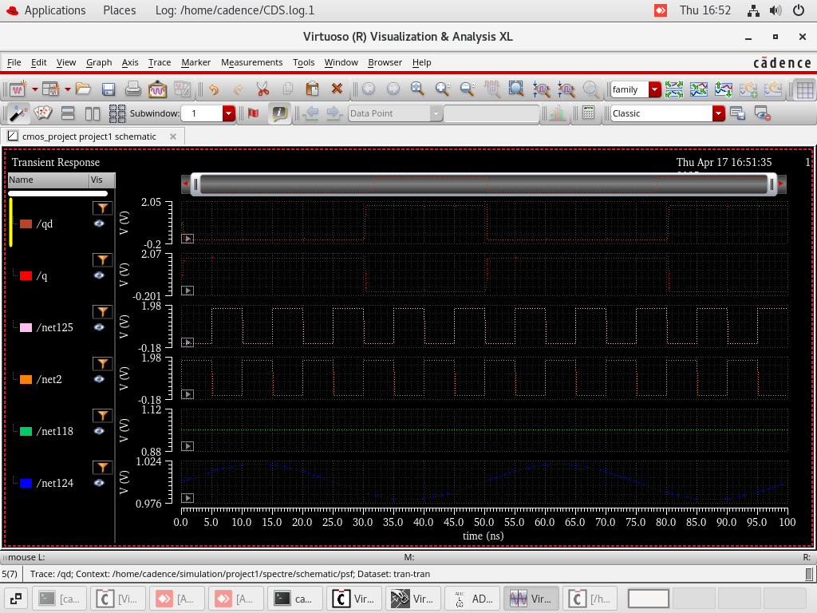
Simulation and Output Analysis

Slide 9
Simulation and Output Analysis
The comparator circuit was designed and simulated using Cadence Virtuoso.
The schematic shows a CMOS-based 8-bit comparator using transistor-level implementation.
The circuit compares two 8-bit input signals and outputs either logic high or low based on the comparison result.
The transient analysis waveform displays internal signals such as /q, /qd, and intermediate nodes.
Inputs include sinusoidal and square waveforms to simulate changing voltage levels.
Output transitions correctly between high and low states, verifying proper comparator behavior.
The simulation confirms that the comparator reacts accurately to input changes, demonstrating correct timing and switching.
These outputs validate the functional accuracy of the design under multiple test cases.
This circuit can be used in ADCs, digital logic systems, and embedded devices for high-speed binary comparison tasks.

Slide 10
Advantages of the Comparator
Simple and fast implementation
Correct digital output without offset correction
Uses dynamic latch for high-speed operation
Low power design
Good behavior with sine vs DC input

Slide 11
Conclusion
Successfully implemented the first comparator circuit from the paper
Verified functionality through simulation:
Output Q responds correctly to input differences
No need for small signal model in our test
Ready for further expansion to ADC application

